Slide 1

DoctorPulse: Offline AI for Health & Harvest
Your Dual-Purpose Offline AI Assistant
Presented by: Raja Danish Ali

Slide 2
The Problem: Gaps in Critical Information
Limited Access to Expertise
Connectivity Barriers
Information Overload & Misinformation
Millions lack immediate access to qualified medical or agricultural advice, especially in remote areas or during emergencies.
Dependence on internet for information hinders quick decision-making in critical health moments or for urgent crop issues.
Online searches often lead to unreliable or overwhelming data, making it hard to find trustworthy, relevant advice.

Slide 3
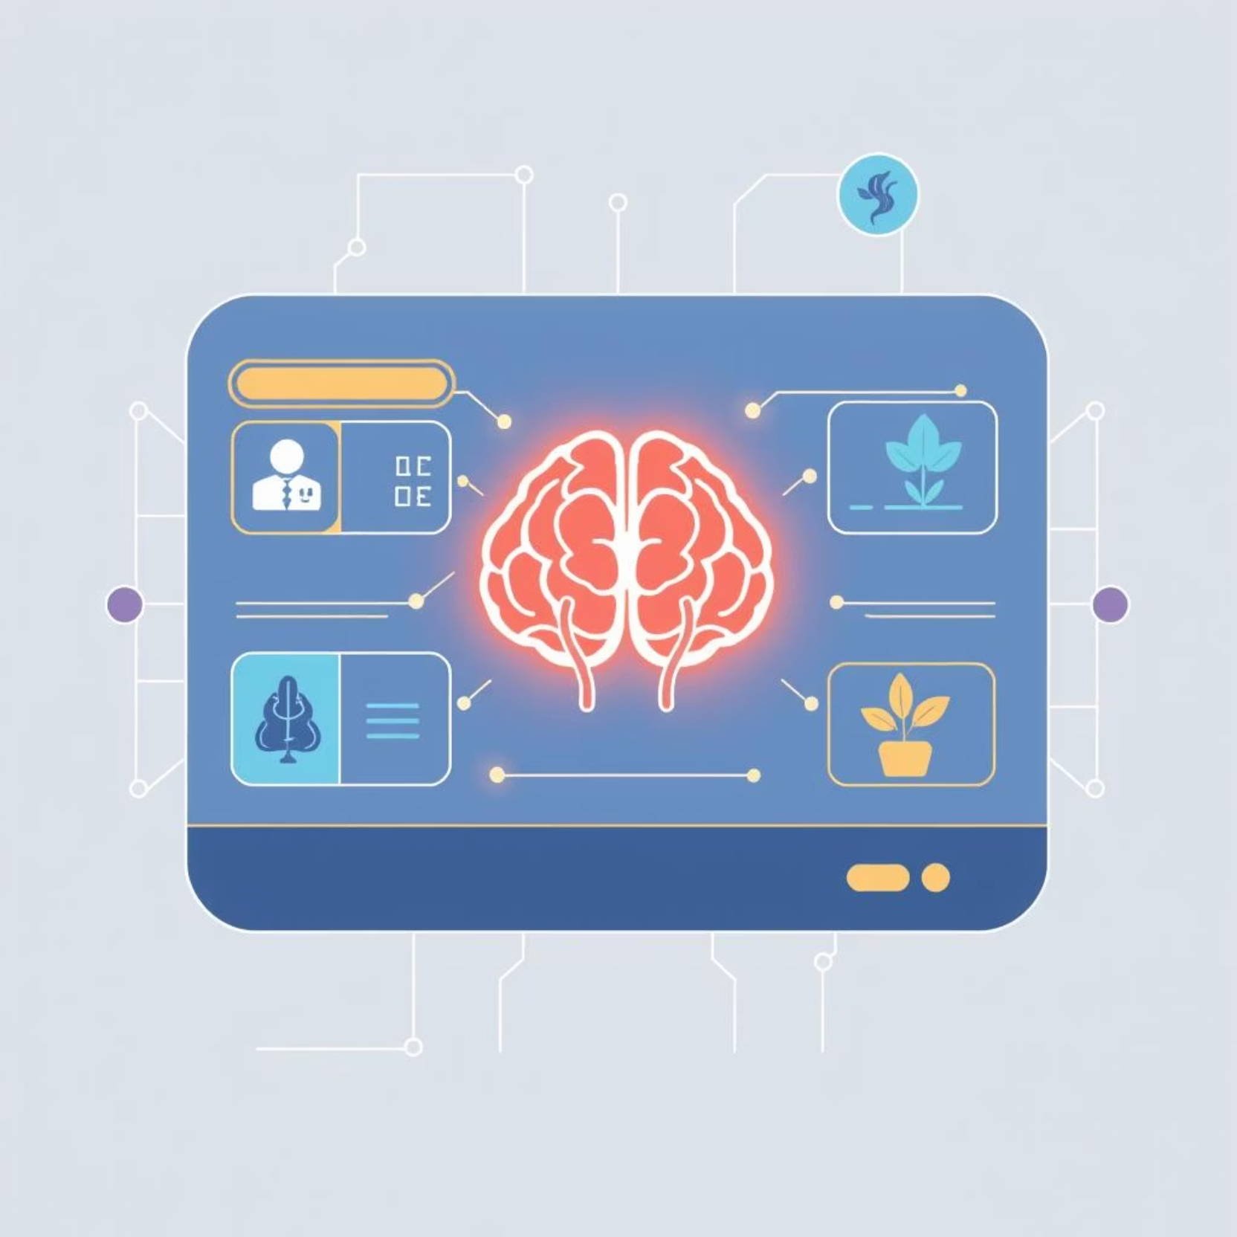
DoctorPulse: Our Innovative Solution
DoctorPulse is an offline AI chatbot designed to bridge crucial information gaps in two vital domains:
Healthcare Support: Provides initial medical guidance and general health advice.
Crop Care Support: Offers insights on plant diseases and farming best practices.
It delivers instant, reliable information without an internet connection, ensuring support is always available.

Slide 4




Key Features: Empowering Users
100% Offline Capability
Google Gemma 3n 2B
All functionalities, including AI inference, work completely without an internet connection, ideal for remote use.
Powered by a fine-tuned Gemma model, ensuring efficient, high-quality AI responses locally.
Multimodal Input/Output
Dual-Purpose AI
Supports text, image uploads, and voice input/output for a truly intuitive user experience.
Seamlessly switches between healthcare and crop care assistance, addressing diverse user needs.

Slide 5

Architecture: How DoctorPulse Works
User Input
Gradio Interface
Gemma Model
Multimodal Output
DoctorPulse leverages a robust, efficient architecture:
Gradio UI: Provides an intuitive web interface for user interaction.
Fine-tuned Gemma 3n 2B: The core AI engine, optimized for specific medical and agricultural datasets.
Google Colab: The development and deployment environment, enabling rapid prototyping and accessibility.

Slide 6

Why Gemma 3n 2B? A Strategic Choice
Our selection of Google's Gemma 3n 2B was critical for DoctorPulse's success due to its:
Optimal Size for Edge Devices: Small enough (2 billion parameters) for efficient local execution without compromising performance.
Strong Performance: Delivers high-quality, relevant responses despite its compact size, crucial for accurate advice.
Offline Capability: Designed to run efficiently offline, making it perfect for our core value proposition.
Fine-tuning Potential: Easily adaptable to specialized datasets (medical/agricultural) for enhanced domain expertise.

Slide 7
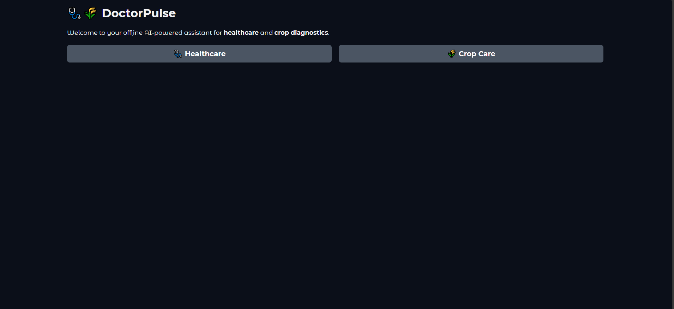
DoctorPulse in Action: UI Preview
See the seamless user experience of DoctorPulse's Gradio UI, demonstrating multimodal input and output.

Slide 8
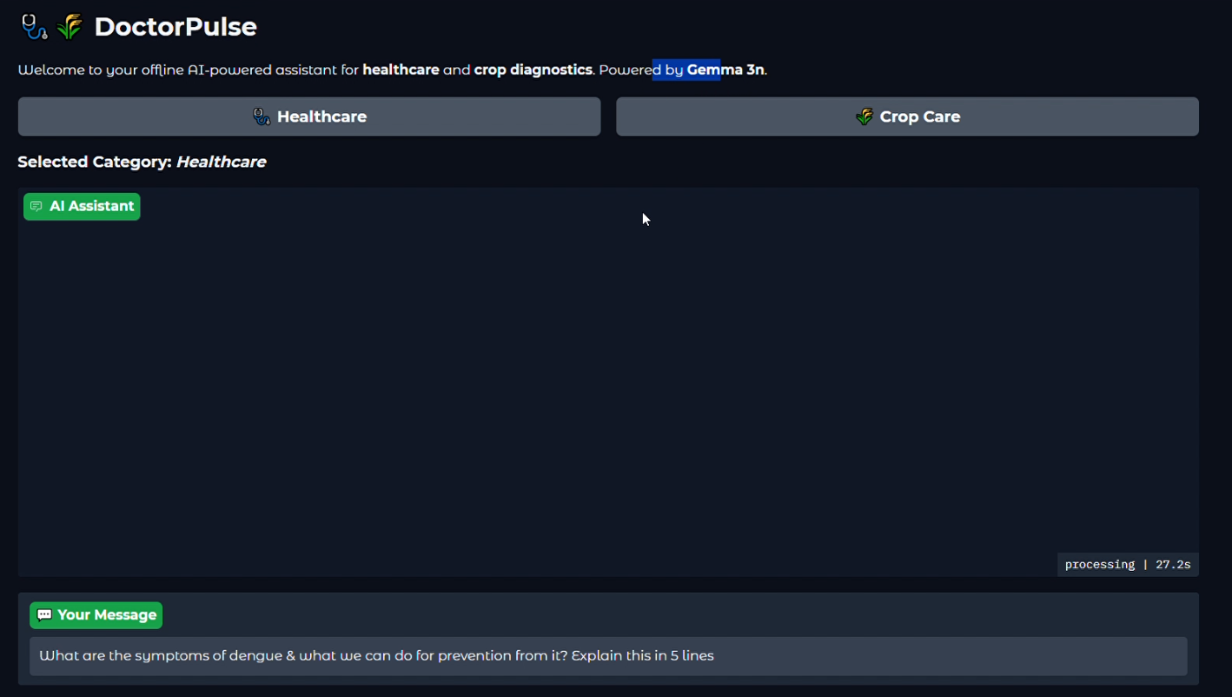

Slide 9




Future Scope: Expanding Impact
Enhanced Image Analysis
1
More precise image recognition for complex diagnoses in both medical and agricultural fields.
Mobile Application Development
2
Native iOS and Android apps for broader accessibility and ease of use on personal devices.
Livestock Care Support
3
Integration of animal health and breeding advice, extending agricultural utility.
Proactive Alerts & Monitoring
4
Implementing features for preventative care and early detection based on user input patterns.

Slide 10



Key Takeaways: Our Contribution
Empowering Underserved Communities
Leveraging Cutting-Edge Offline AI
Scalable & Adaptable
A foundation for future expansion into various specialized domains and platforms.
Providing vital information where internet access is limited or non-existent.
Showcasing the power of localized AI models for practical, real-world solutions.

Slide 11

Thank You!
Questions & Discussion
Contact: rajadanish.ist@gmail.com

